Slide 1


SafeHire
AI Powered Service Hiring Platform
Making service worker hiring safer, smarter, and more trustworthy through verified digital solutions.

Slide 2

Problems with Offline Hiring
Addressing Safety and Efficiency Challenges
Offline hiring poses significant risks such as fraud, theft, and lack of accountability. These issues create an inconvenient experience for both employers and potential workers, necessitating the need for a safer solution.

Slide 3
Proposed Solution
Four-Layer Verification
NID Verification
Address Verification
Social Reference Checks
The implementation of the four-layer verification system will enhance service hiring by ensuring comprehensive checks on potential workers, mitigating risks effectively and efficiently.
Utilizing national identification verification, we confirm workers' identities, significantly reducing the chances of hiring unverified and potentially fraudulent individuals in the service industry.
GPS-based address verification ensures candidates are located where they claim, allowing employers to verify not only the identity but also the physical presence of potential hires.
Conducting social reference checks offers insights into candidates’ reliability and work history, fostering trust between employers and workers before the hiring process is finalized.

Slide 4
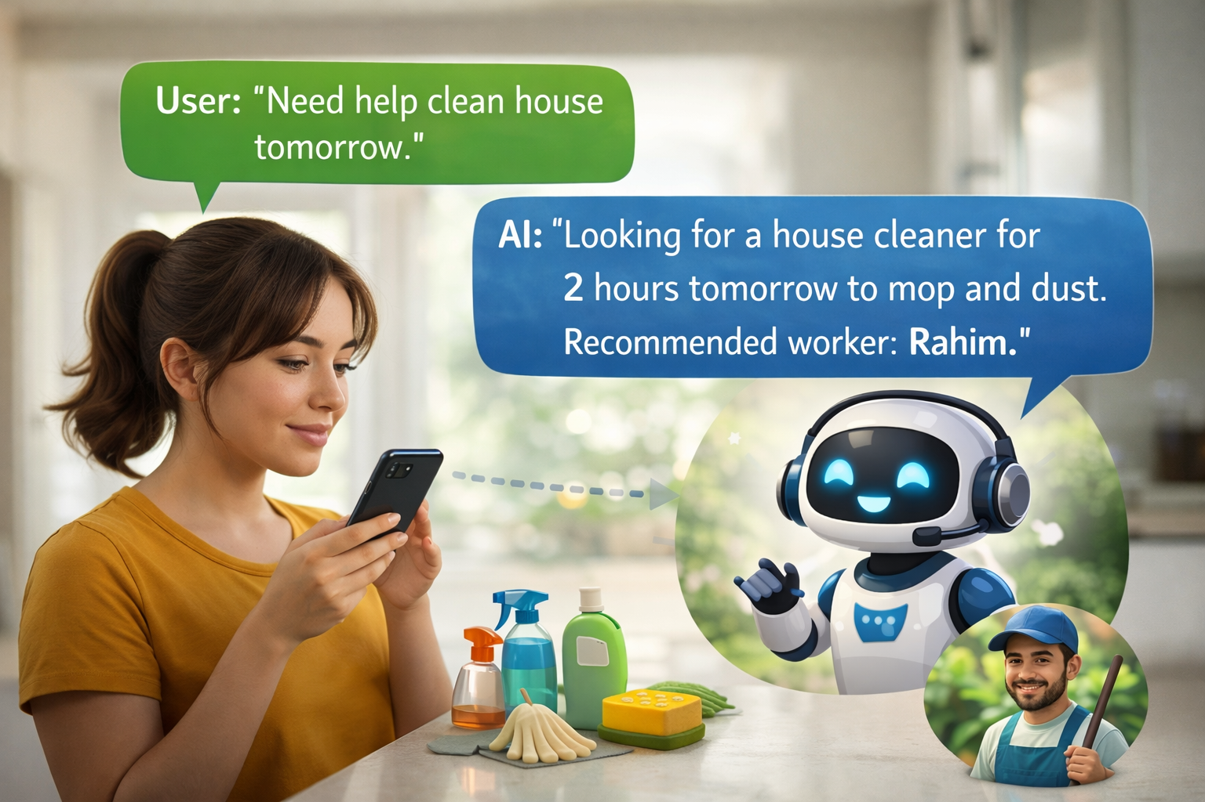

Key Features
Innovative Tools for Efficient Hiring
Job Description Generator
Smart Matching
24/7 AI Support
The AI Job Description Generator simplifies the recruitment process by creating tailored job descriptions that attract the right candidates while saving time and ensuring clarity in expectations.
Our Smart Candidate Matching system utilizes advanced algorithms to connect employers with candidates who possess the right skills and qualifications, enhancing the chances of successful hires significantly.
The 24/7 AI Chatbot provides immediate assistance to both employers and candidates, answering queries and facilitating communication at any time, ensuring a smoother hiring experience for all parties.
7

Slide 5
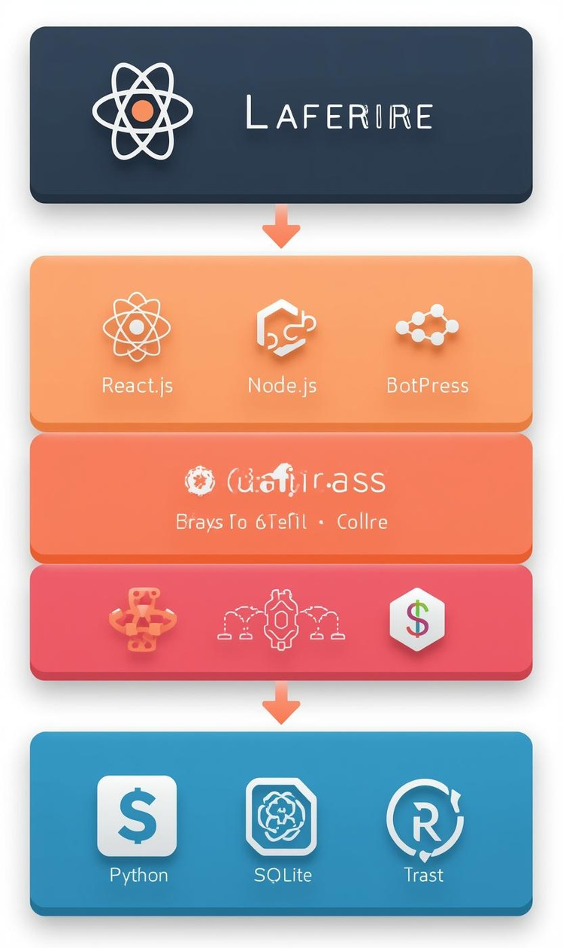
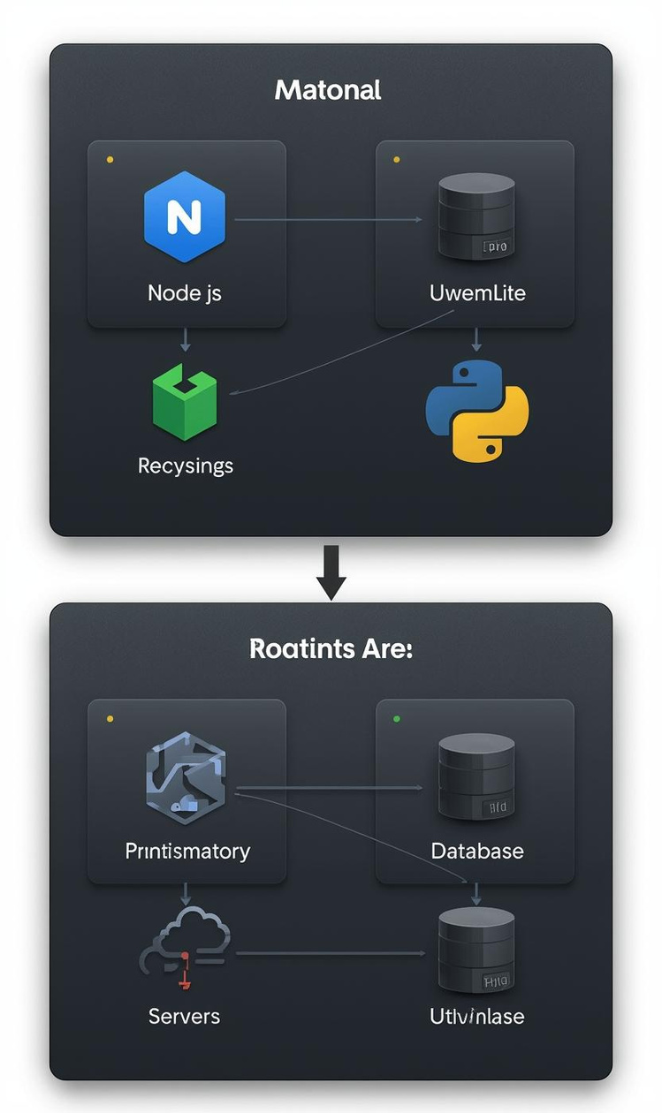
SafeHire Technology Stack Overview
Frontend
Backend
Built using React.js for a responsive UI
Employs Node.js and Python for efficient processing

Slide 6
Project Timeline
Core Platform Development
Verification System
AI Integration
Testing
The project will commence with the development of the core platform, focusing on essential functionalities to ensure a smooth user experience and secure hiring processes.
During this phase, the multi-layer verification system will be implemented, ensuring the integrity of worker profiles and establishing a robust platform for secure hiring.
The integration of AI technologies will enhance the platform's capabilities, allowing for more efficient candidate matching and risk assessment processes, significantly improving overall functionality.
Finally, rigorous testing will be conducted to fine-tune the platform, followed by the official launch, marking the start of SafeHire's operations in the service hiring industry.

Slide 7

Mission and Vision of SafeHire
SafeHire aims to create a hassle-free and secure hiring environment by ensuring transparency and trust. Our vision is to set the standard for service workforce hiring across local and national levels.

Slide 8
Future Roadmap
Web Platform Launch
Mobile Application
Scale Workforce
Subscription Model
The initial phase involves launching the SafeHire web platform, providing users with an efficient interface for secure service hiring and access to AI-driven features.
Following the web platform, a mobile application will be developed, ensuring accessibility for users on-the-go and enhancing the overall user experience for hiring services.
Once the platform and app are established, efforts will focus on scaling the workforce capabilities to accommodate a larger pool of service providers and employers.
Finally, SafeHire aims to introduce a subscription-based revenue model, providing sustained funding for continuous improvement and expansion of services and features offered on the platform.

Slide 9

Conclusion
SafeHire enables safe and verified hiring
AI and verification reduce fraud and risk
Employers hire faster and with confidence
Workers get fair and trusted job access
The platform makes service hiring simple and secure
Thank you for your attention!

